Slide 1
Homework

Slide 2
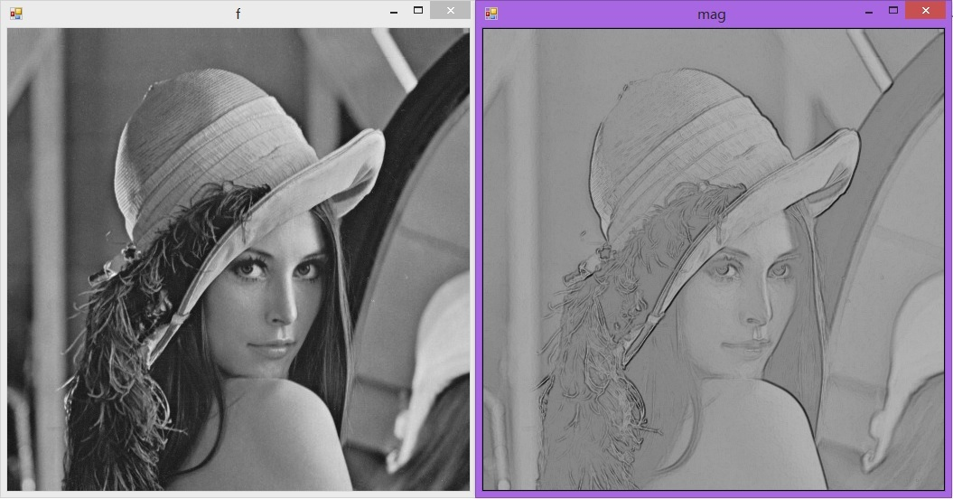
Homework II
Algorithm Develop
Left image is the input image and right image is the output image.
Single PDF File
File Name is your H2-[your student ID]-[your name].PDF
Include source code, input image & output image, description of your algorithm
Using C—(C# Script) or C++(Open CV)
Submit to your TA (Yang Li, yangl9394@163.com)
Deadline is December 12

